Slide 1
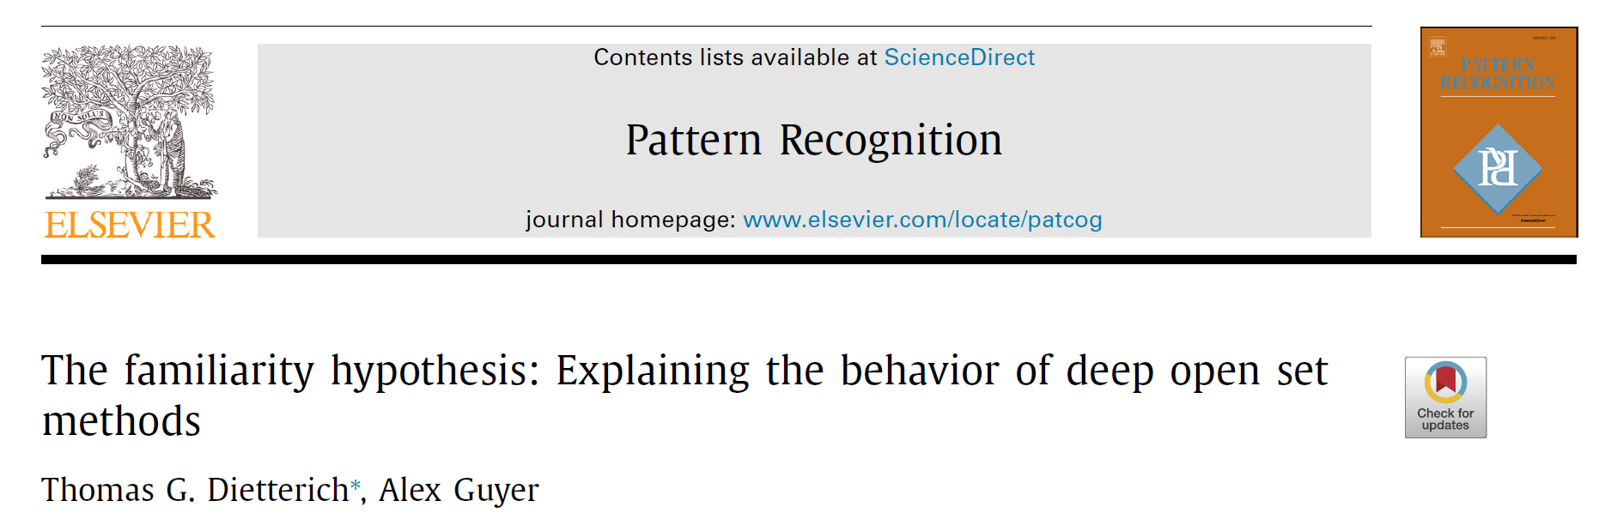
Citations: 10 (2023/03/23)
Published in Pattern Recognition 2022
Mingle Xu
2023 March 24

Slide 2
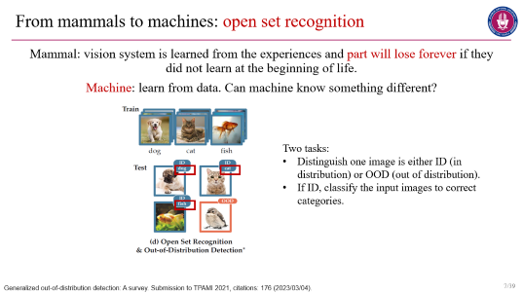
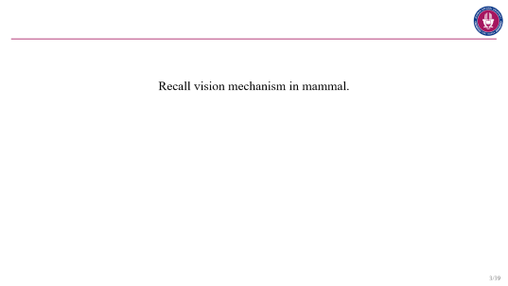
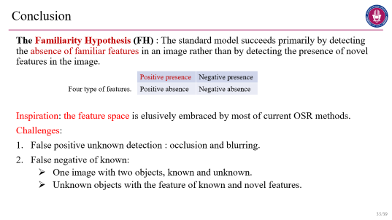
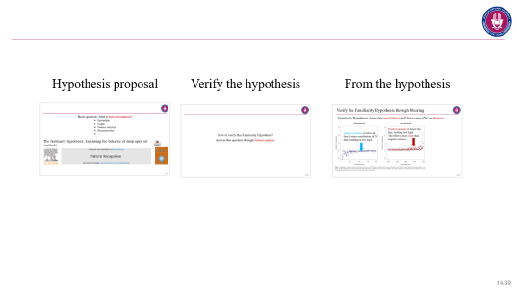
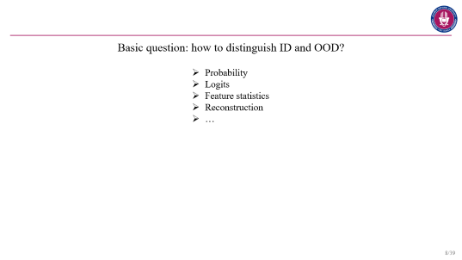
Contents
Recall vision
Open set recognition
One question
Main part
Conclusion

Slide 3
Recall vision mechanism in mammal.

Slide 4
Human
What will happen if the blind people can see?
In 1932, a doctor found that many recovered blind people suffer from the vision deficiency, one people suicided because of deep depression after the eye surgery.
In India, some people are blind when born, cataract, because of nutrition deficiency. The recovered people can not adapt themselves.
However, those people who lose their eyesight after they born behave normally after recovering.
wikipedia

Slide 5
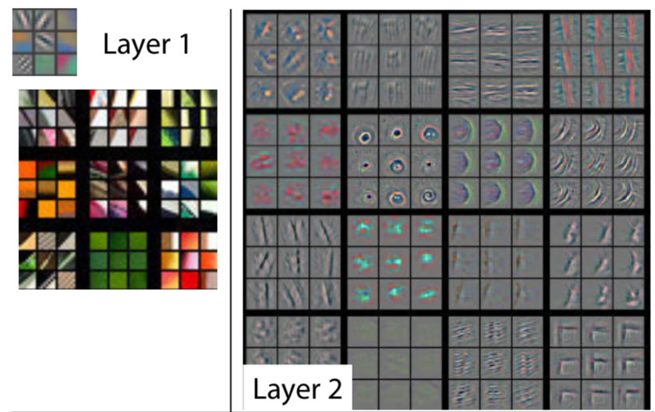
Cat
Visual experiments on cats.
In 1958, neurons in cats are respond to edges with different orientation (Nobel Prize, Hubel and Wiesel), having profound impact on many computer vision algorithms such as the Gabor filter.
Experiment: sew cats’ eyes after born and remove the line, the eyes seem lost forever.
ZFNet
Receptive fields of single neurones in the cat's striate cortex. The Journal of physiology 1959, citations: 6,395 (2023/03/23).
ZFNet. Visualizing and understanding convolutional networks. ECCV 2014, citations: 18,784 (2023/03/23).

Slide 6
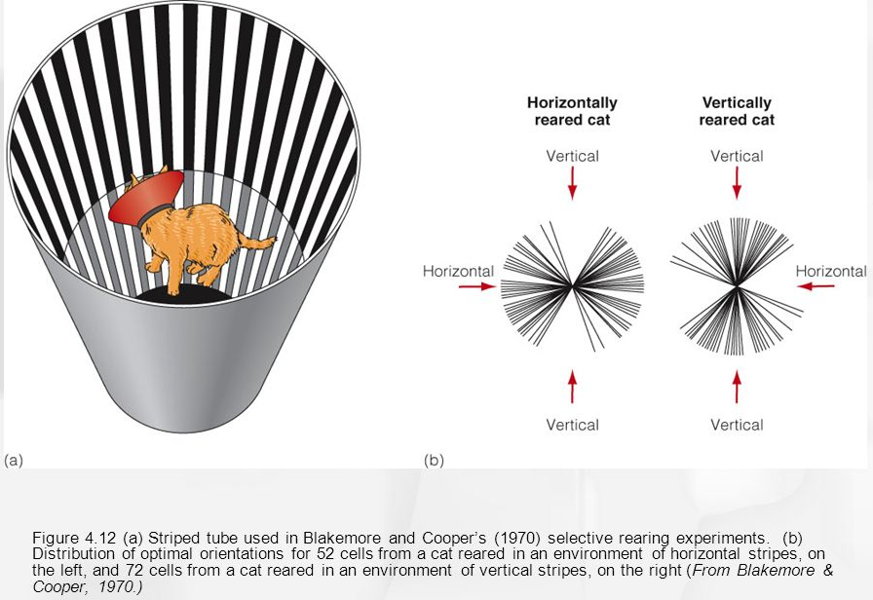
Cat
The ability to see of cat is innate or acquired?
Kittens that only perceive vertical lines for the first few month of birth could only see vertical lines not horizontal lines for the rest of their life.
Two weeks after born, last three months.
Video in a website.
3:30 – Without visual placing reaction
4:42- No startled reaction
Recovered few days latter.
6:07- only has reaction in horizontal but not in vertical.
More info in Chinese
Development of the brain depends on the visual environment. Nature 1970, citations: 1,452 (2023/03/14).

Slide 7
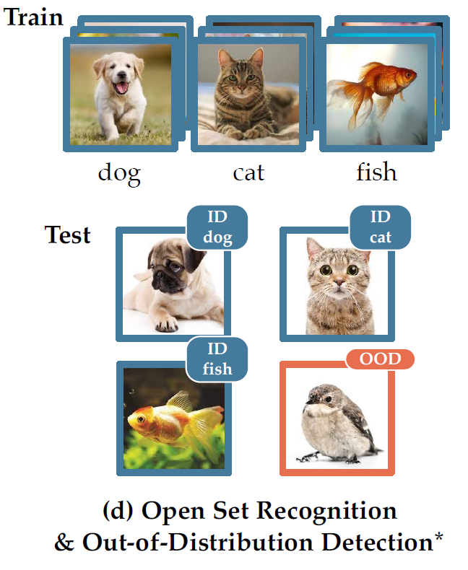
From mammals to machines: open set recognition
Mammal: vision system is learned from the experiences and part will lose forever if they did not learn at the beginning of life.
Machine: learn from data. Can machine know something different?
Two tasks:
Distinguish one image is either ID (in distribution) or OOD (out of distribution).
If ID, classify the input images to correct categories.
Generalized out-of-distribution detection: A survey. Submission to TPAMI 2021, citations: 176 (2023/03/04).

Slide 8
Basic question: how to distinguish ID and OOD?
Probability
Logits
Feature statistics
Reconstruction
…

Slide 9
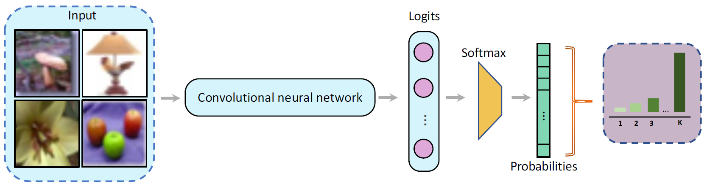
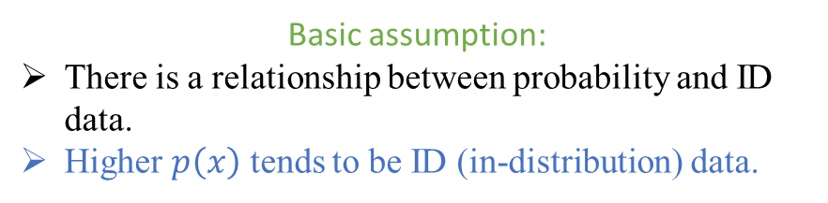
Related work
Probability: maximum softmax probability (MSP)
Logits
Feature statistics
Reconstruction
…
Applications:
Computer vision, MNIST, CIFAR10, CIFAR100.
NLP: sentiment classification.
Speech recognition.
Basic assumption:
There is a relationship between probability and ID data.
Higher $p\left(x\right)$ tends to be ID (in-distribution) data.
A Baseline for Detecting Misclassified and Out-of-Distribution Examples in Neural Networks. ICLR 2017, citation: 1,987 (2023/03/04).

Slide 10
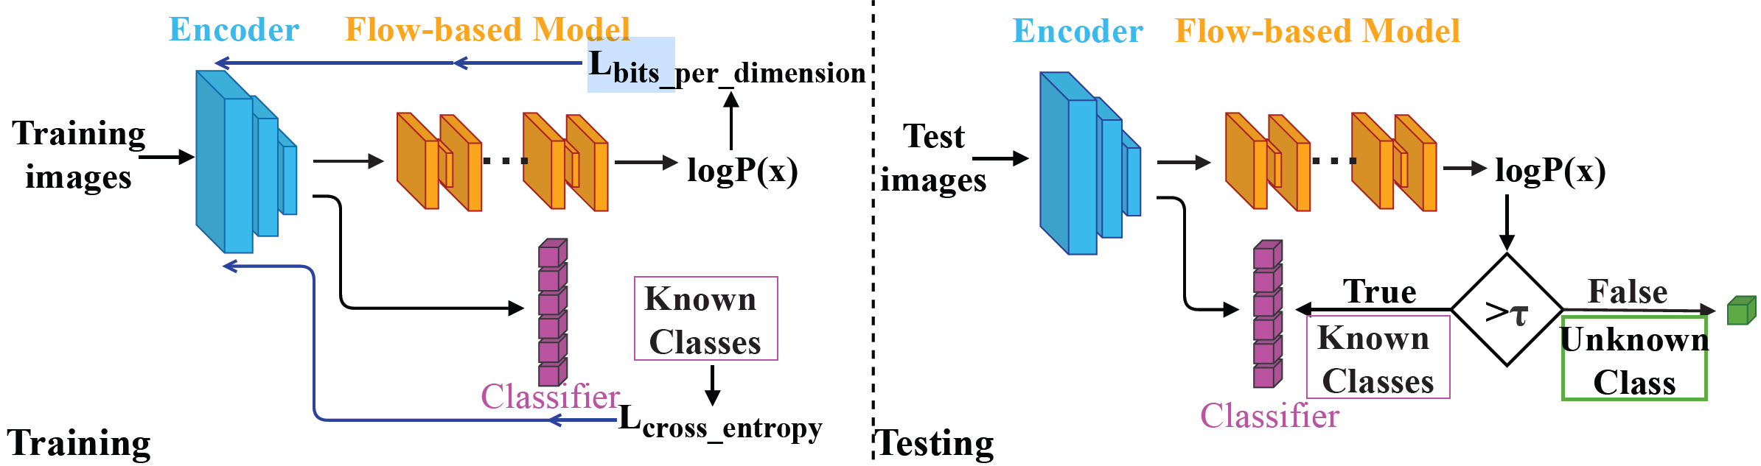
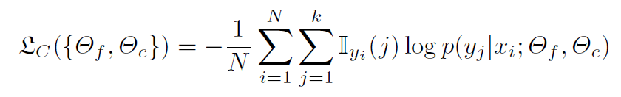
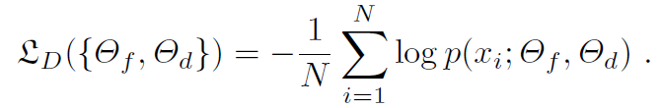
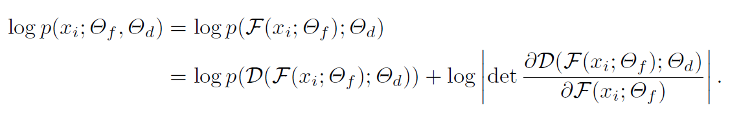
Related work
Probability: model the probability using density model
Logits
Feature statistics
Reconstruction
…
Classification loss
Density loss
Hybrid models for open set recognition. ECCV 2020. Citation: 104 (2023/03/08).

Slide 11
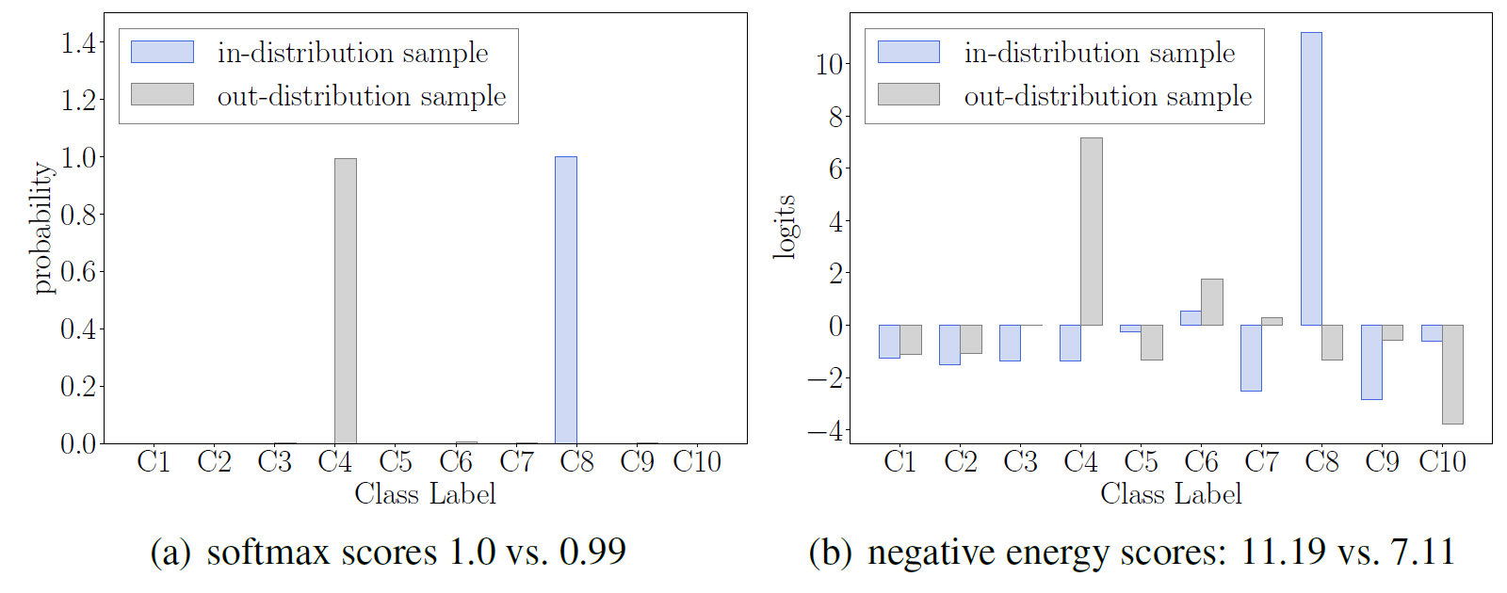
Probability
Logits
Feature statistics
Reconstruction
…
The probability after Softmax is normalized and relative.
A small logit score may result in a high $p(x)$.
Energy-based, not normalized and relative.
Vaze, Sagar, et al. "Open-set recognition: A good closed-set classifier is all you need." ICLR 2022. Citation: 89 (2023/3/6)
Liu, Weitang, et al. "Energy-based out-of-distribution detection." NIPS 2020. citation: 399 (2023/3/6)

Slide 12
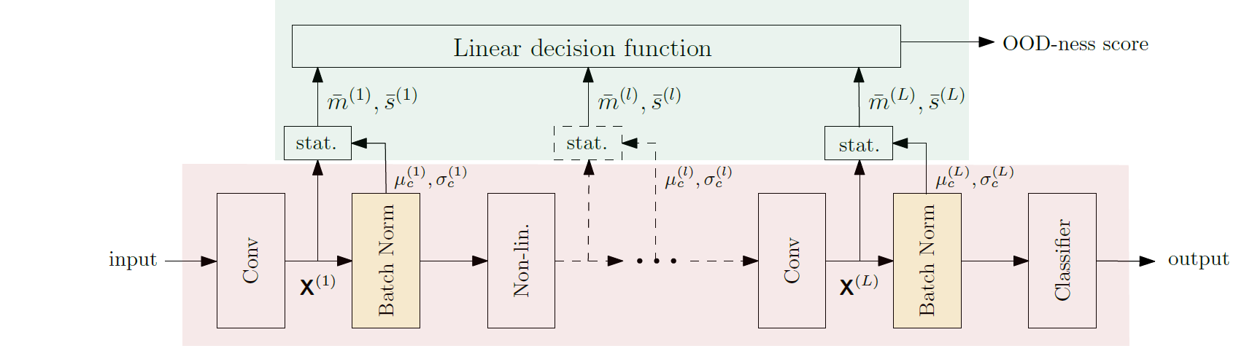
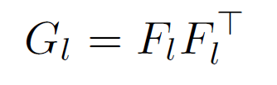
Probability
Logits
Feature statistics: mean and variance
Reconstruction
…
Quintanilha, Igor M., et al. "Detecting out-of-distribution samples using low-order deep features statistics." ICLR 2019 rejected, citations: 3 (2023/3/6)
Sastry, Chandramouli Shama, and Sageev Oore. “Detecting out-of-distribution examples with gram matrices.” ICML 2020, citations: 139 (2023/3/6)

Slide 13
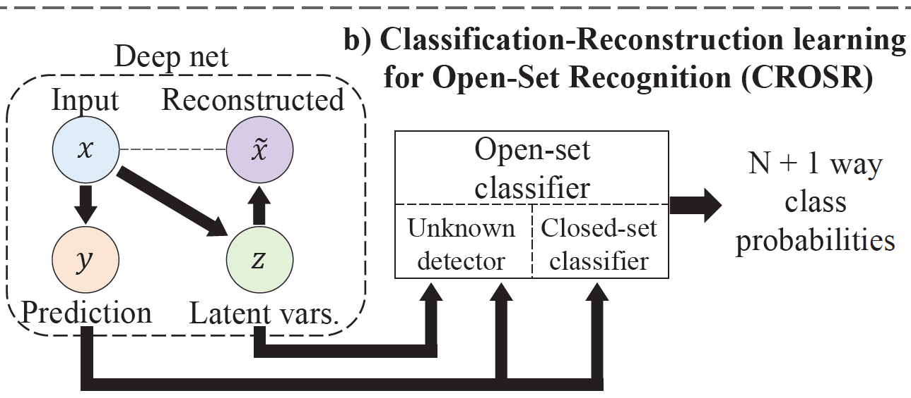
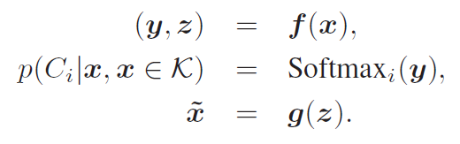
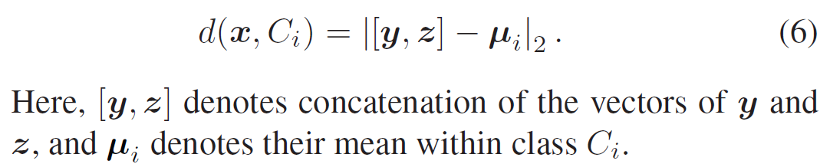
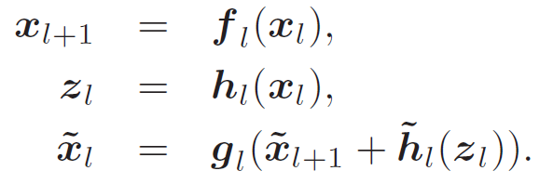
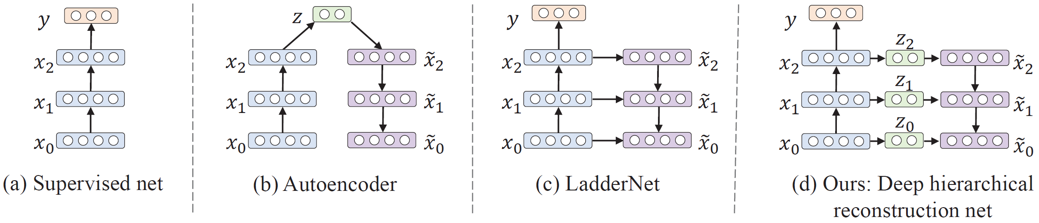
Probability
Logits
Feature statistics
Reconstruction
…
Advantage: hidden in the input data but vanish in the middle of the inference chains.
Classification-reconstruction learning for open-set recognition. CVPR 2019. Citation: 248 (2023/03/13).

Slide 14
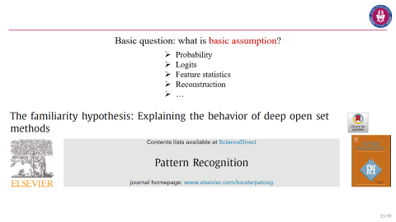
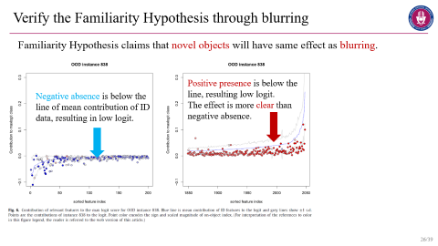
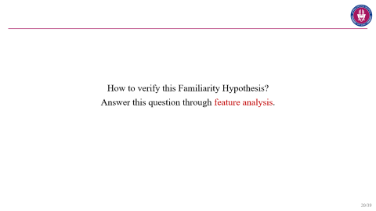
Hypothesis proposal
Verify the hypothesis
From the hypothesis

Slide 15
Basic question: what is basic assumption?
Probability
Logits
Feature statistics
Reconstruction
…

Slide 16
The Familiarity Hypothesis (FH) : The standard model succeeds primarily by detecting the absence of familiar features in an im- age rather than by detecting the presence of novel features in the image.
Four type of features for a category.
Positive presence | Negative presence
Positive absence | Negative absence
Recall the horizontal and vertical line changes.

Slide 17
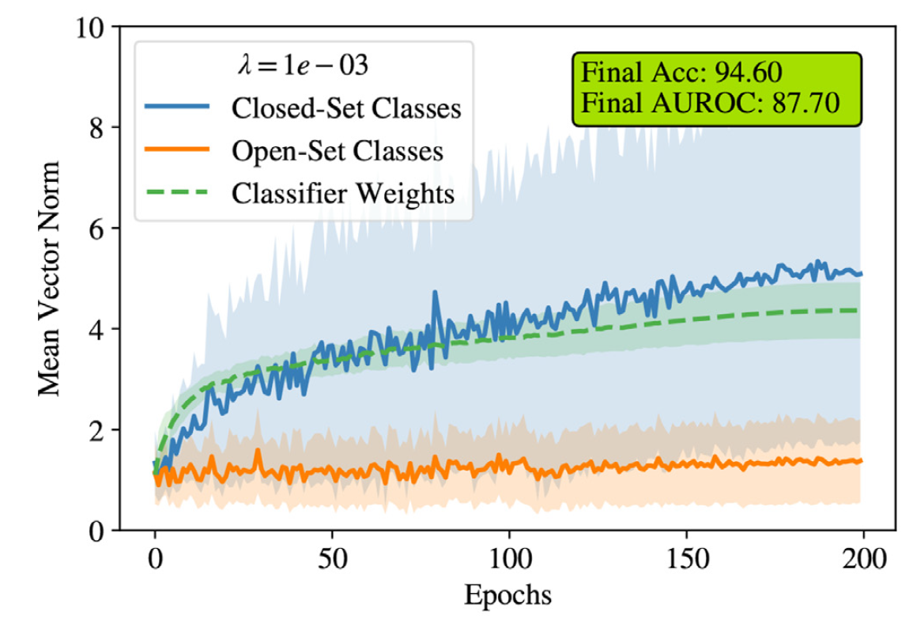
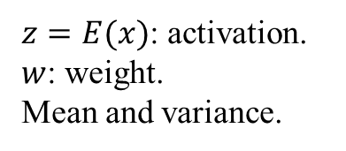
Evidence of FH: activation
$z=E(x)$: activation.
$w$: weight.
Mean and variance.
How to understand this low norm?

Slide 18
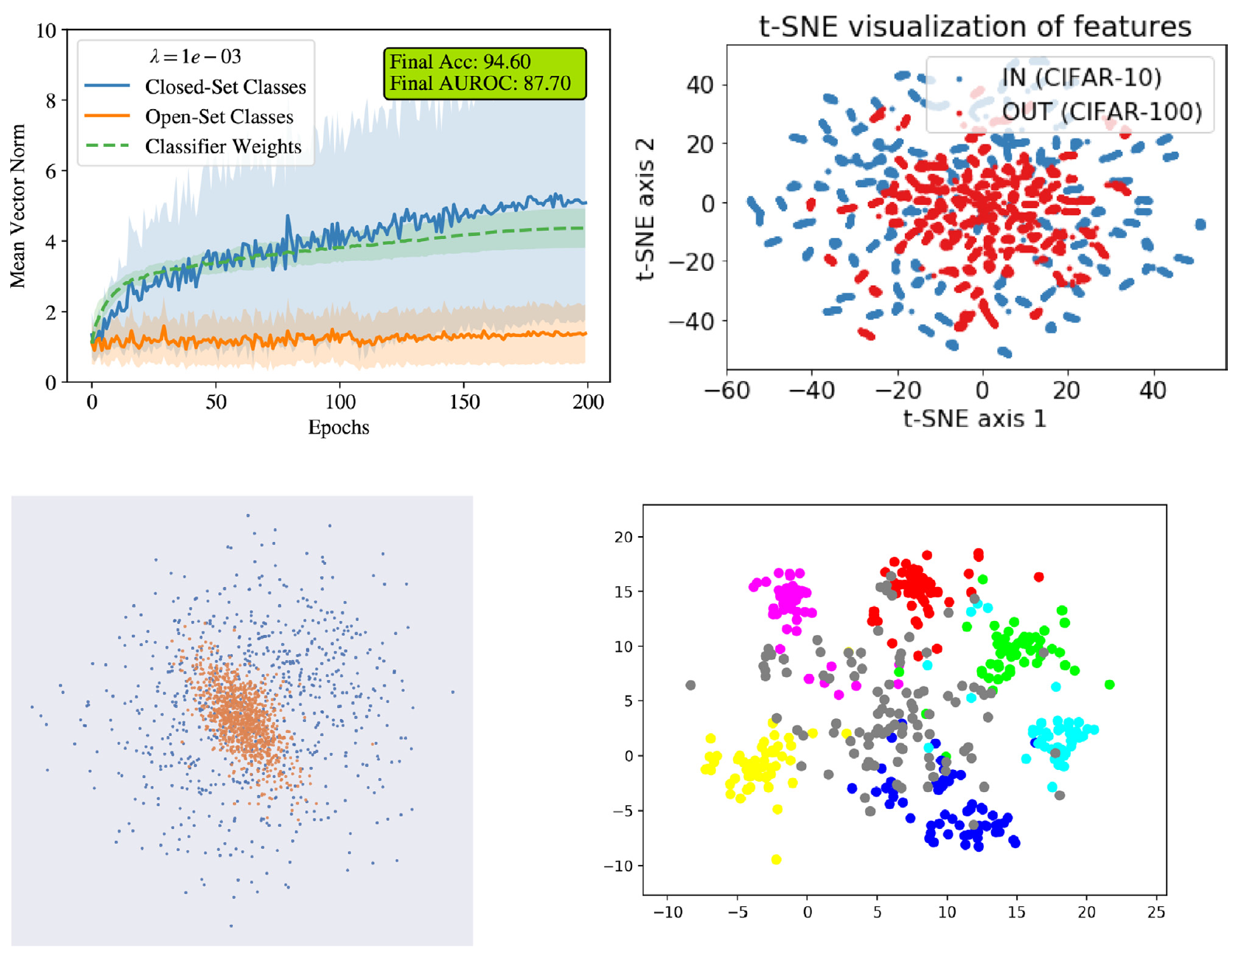
Evidence of FH: activation
Smaller $z$ results from multiple dimensions.
My thinking: this declare may be not true. Projection loses some info in the original feature dimensions.

Slide 19
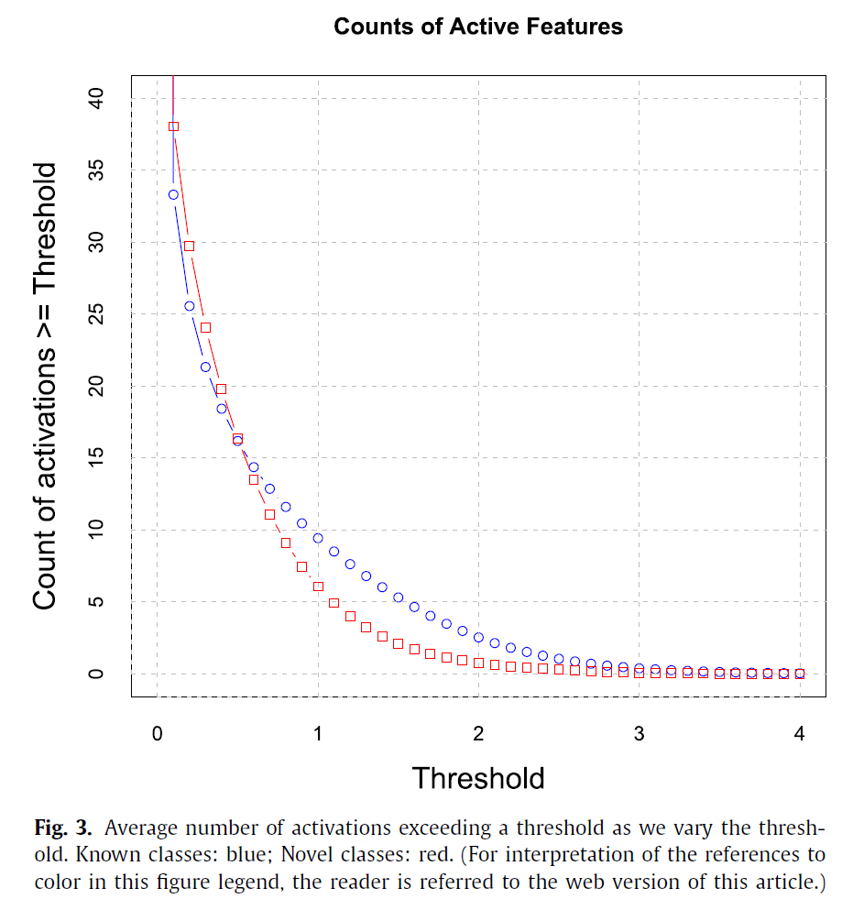
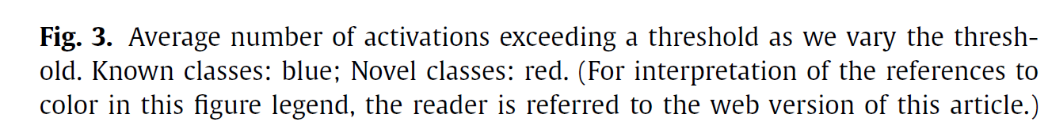
Evidence of FH: activation
Smaller norm of activation $z$ results from few number of activated features.
My thinking: this claim seems more correct.
Count the number of features large than a threshold.

Slide 20
How to verify this Familiarity Hypothesis?
Answer this question through feature analysis.

Slide 21
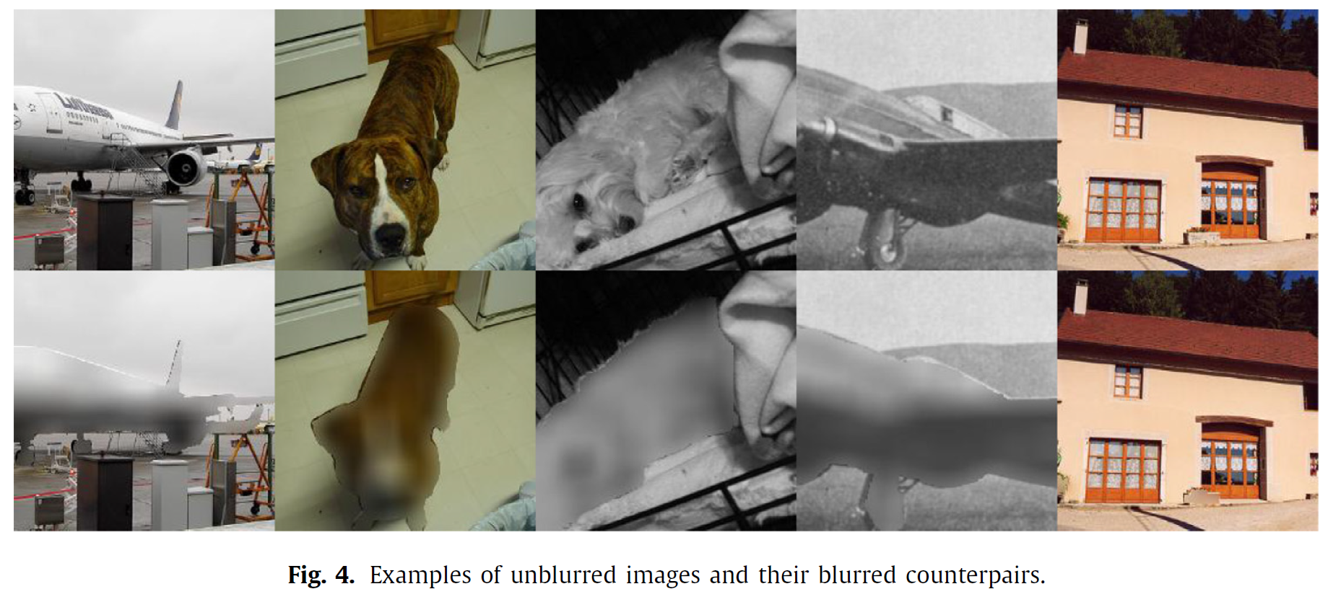
Verify the Familiarity Hypothesis through blurring
Thinking the feature differences: given a trained-well model, the features that are activated in images of known, and that are not activated in the images of unknown, should be the features that describe the object itself rather than the background.
Shapes and edges are not changed.
Futures change between the blurring and unblurring images are features that must depend (at least partially) on the segmented object region.

Slide 22
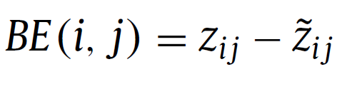
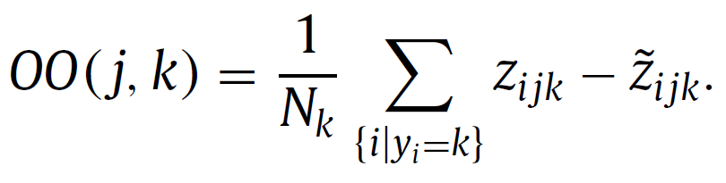
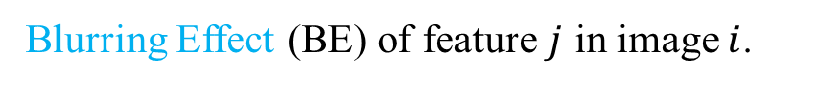
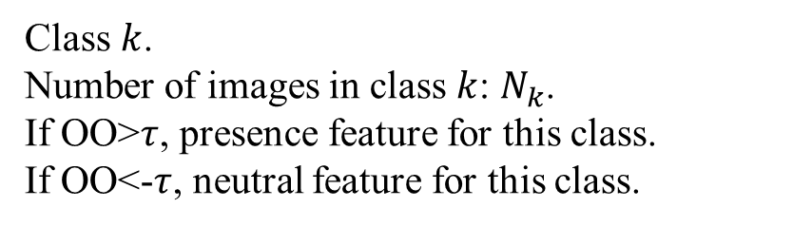
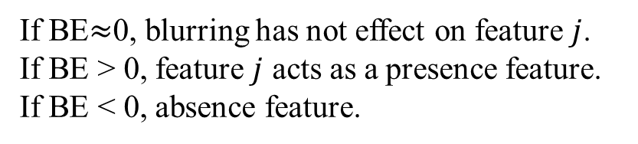
Verify the Familiarity Hypothesis through blurring
Blurring Effect (BE) of feature $j$ in image $i$.
Overall effect of features on class-conditional images: on-object score.
If BE$≈$0, blurring has not effect on feature $j$.
If BE > 0, feature $j$ acts as a presence feature.
If BE < 0, absence feature.
Class $k$.
Number of images in class $k$: $N_{k}$.
If OO>$τ$, presence feature for this class.
If OO<-$τ$, neutral feature for this class.

Slide 23
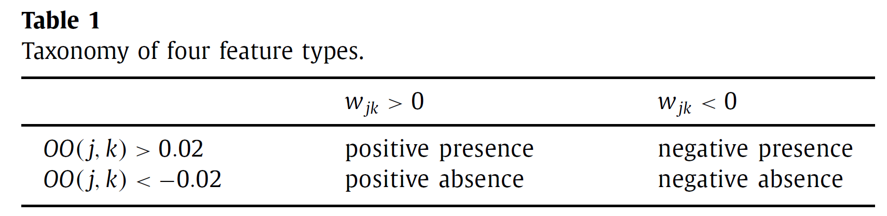
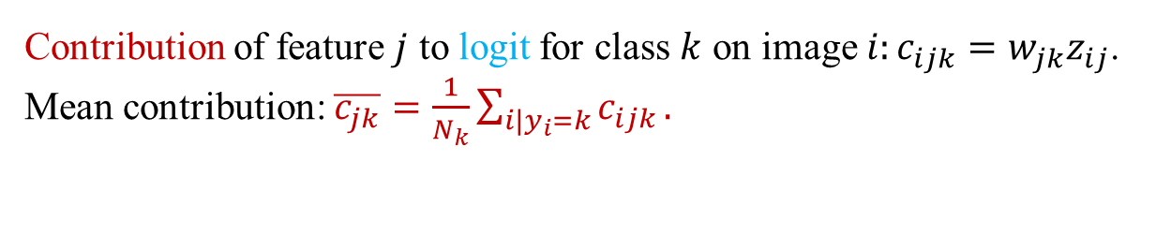
Verify the Familiarity Hypothesis through blurring
Contribution of feature $j$ to logit for class $k$ on image $i:c_{ijk}=w_{jk}z_{ij}\text{.}$
Mean contribution: $\overline{c_{jk}}=\frac{1}{N_{k}}\sum_{i|y_{i}=k}{c_{ijk}}.$

Slide 24
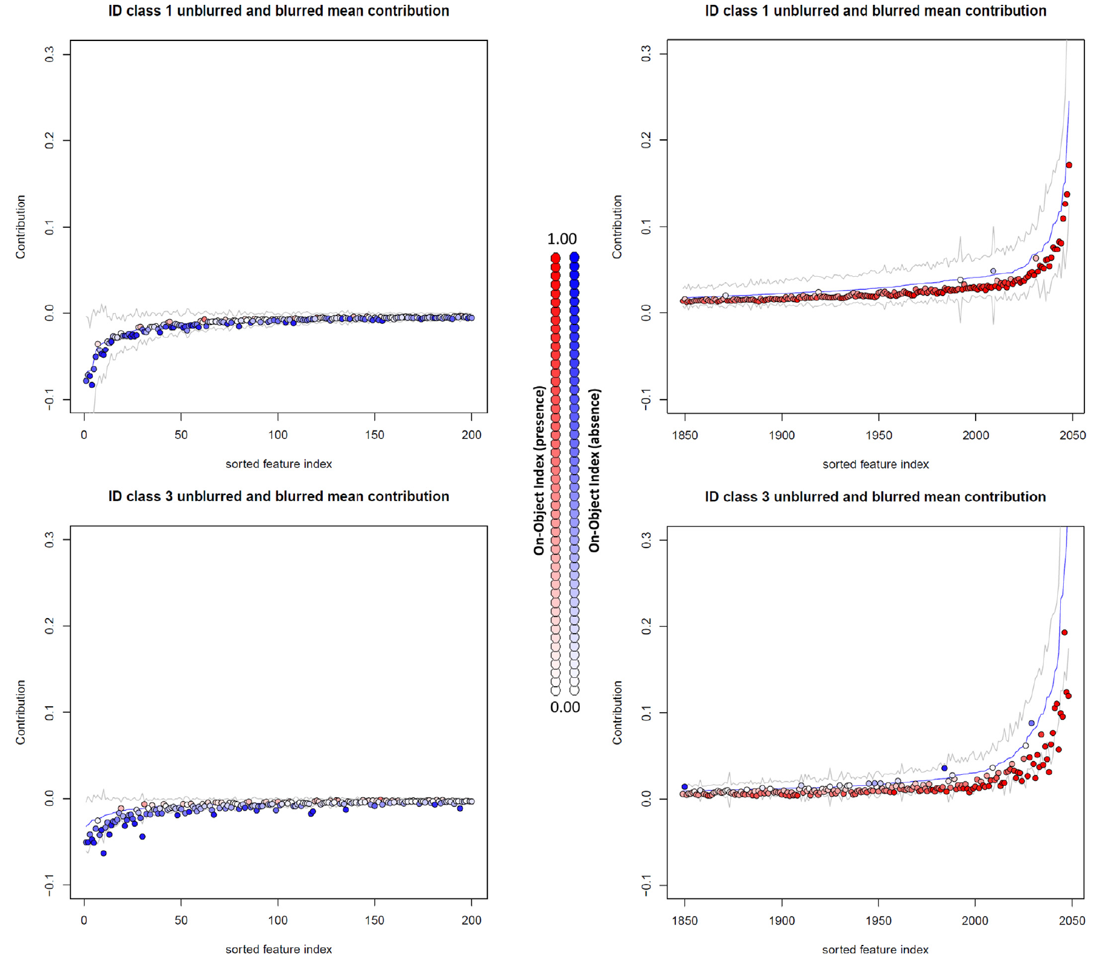
Verify the Familiarity Hypothesis through blurring
Mean contribution of class 1: absence and presence.
Blue line: unblurring
Colored points: blurring.
Negative presence are less.
Negative absence are less.
Blurring has effect on the presence and decreases the logits.

Slide 25
Verify the Familiarity Hypothesis through blurring
Mean contribution of class 3.

Slide 26
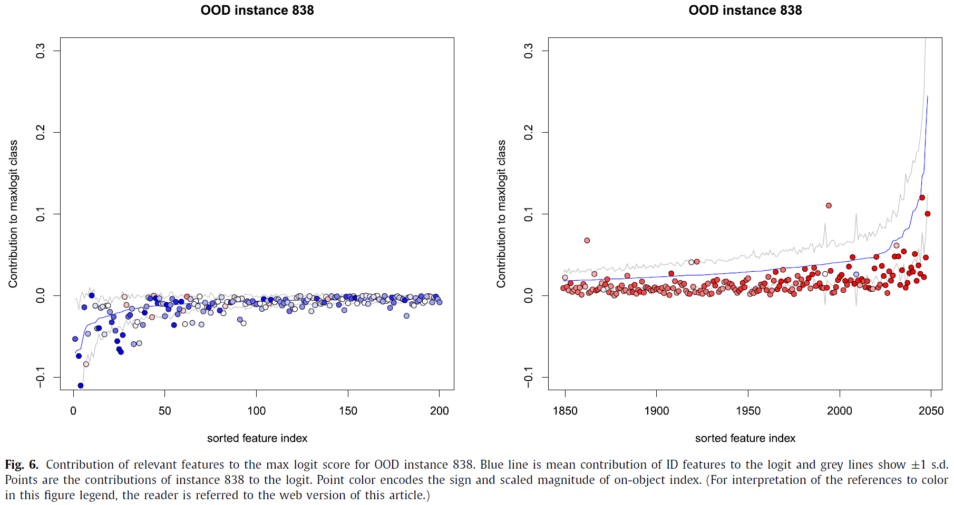
Verify the Familiarity Hypothesis through blurring
Familiarity Hypothesis claims that novel objects will have same effect as blurring.
Positive presence is below the line, resulting low logit.
The effect is more clear than negative absence.
Negative absence is below the line of mean contribution of ID data, resulting in low logit.

Slide 27
Verify the Familiarity Hypothesis through blurring
Decrease in the class k logit score caused by feature j on image i: $δ_{ijk}=\overline{c_{jk}}−c_{ijk}$
Positive presence effect: 6.232.
Negative absence effect: 1.114.
Positive absence effect: 0.050.
Negative absence effect: 0.130.

Slide 28
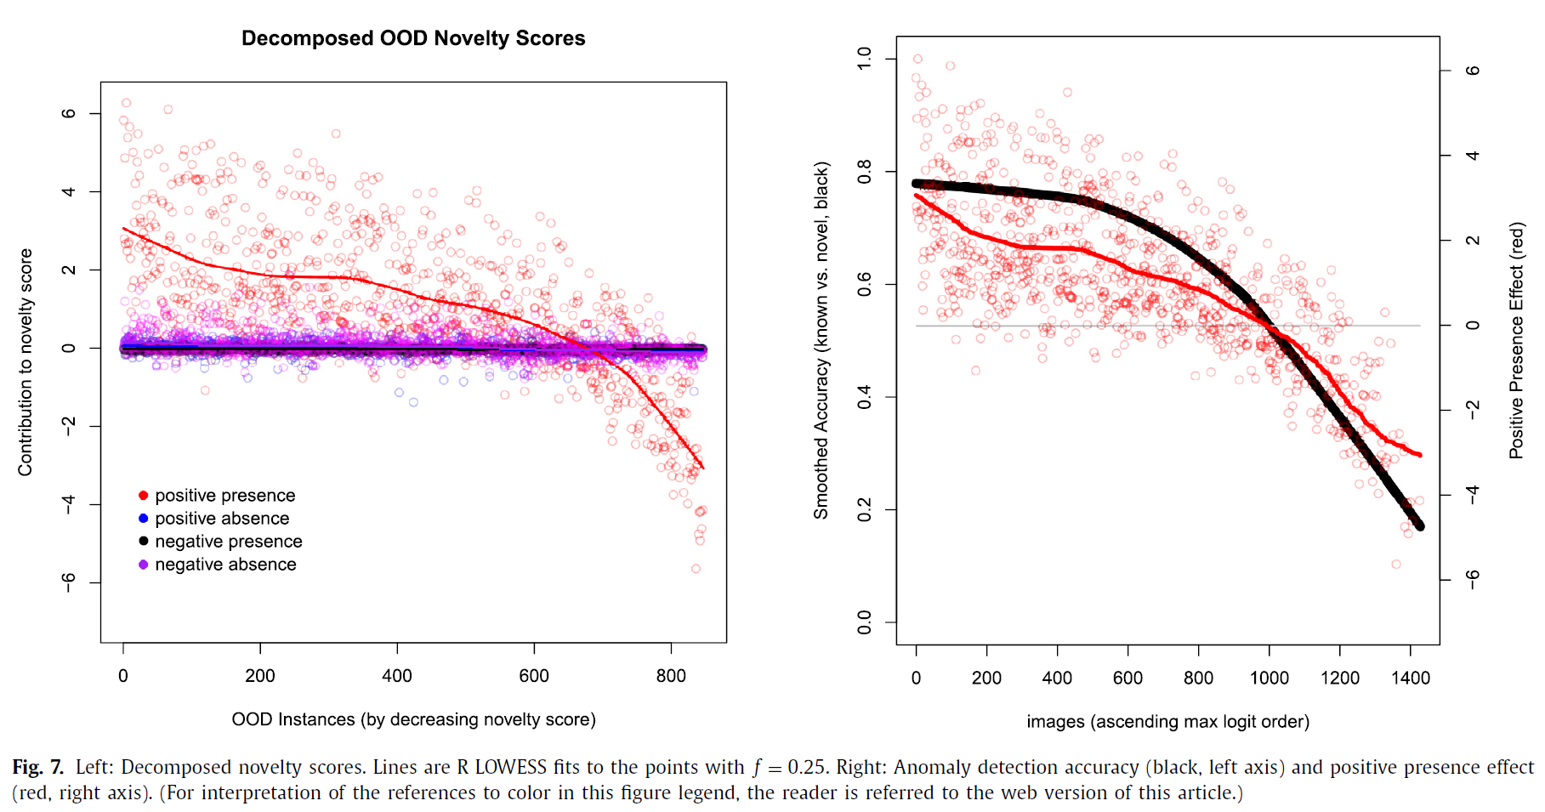
Verify the Familiarity Hypothesis through blurring
Decrease in the class k logit score caused by feature j on image i: $δ_{ijk}=\overline{c_{jk}}−c_{ijk}$
Trends of positive presence.
But negative absence has no effect.
Positive presence | Negative presence
Positive absence | Negative absence
Connection between the contribution of positive presence and OOD accuracy.
To improve the OOD accuracy, it is important to learn more specific on-object features that are not activated by objects belonging to novel classes. But how?

Slide 29
The Familiarity Hypothesis (FH) : The standard model succeeds primarily by detecting the absence of familiar features in an im- age rather than by detecting the presence of novel features in the image.
Four type of features.
Positive presence | Negative presence
Positive absence | Negative absence
What can be got with this familiarity hypothesis?

Slide 30
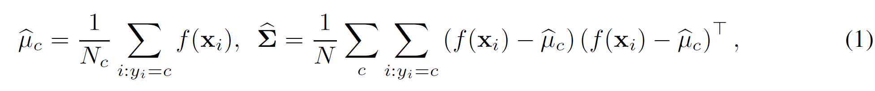
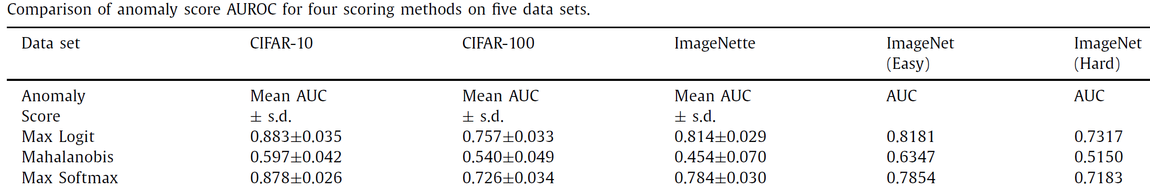
Prediction 1: max logit (class-level) will give better OSR than the Mahalanobis (dataset-level).
Familiarity hypothesis: similar features in class-level is better to recognize than in dataset-level.
A simple unified framework for detecting out-of-distribution samples and adversarial attacks, NIPS 2018, citation: 1,190 (2023/3/23)

Slide 31
Prediction 2: object occlusion will cause false positive novelties.
Positive presence will be reduced, shirking logit score.
Blurring can be viewed as an extreme form of occlusion.
Experiment | AUROC
Unblurring images of know class v.s. Blurred images of unknown class | 0.671
Blurred image of known class v.s. Unblurring images of unknown class | 0.540

Slide 32
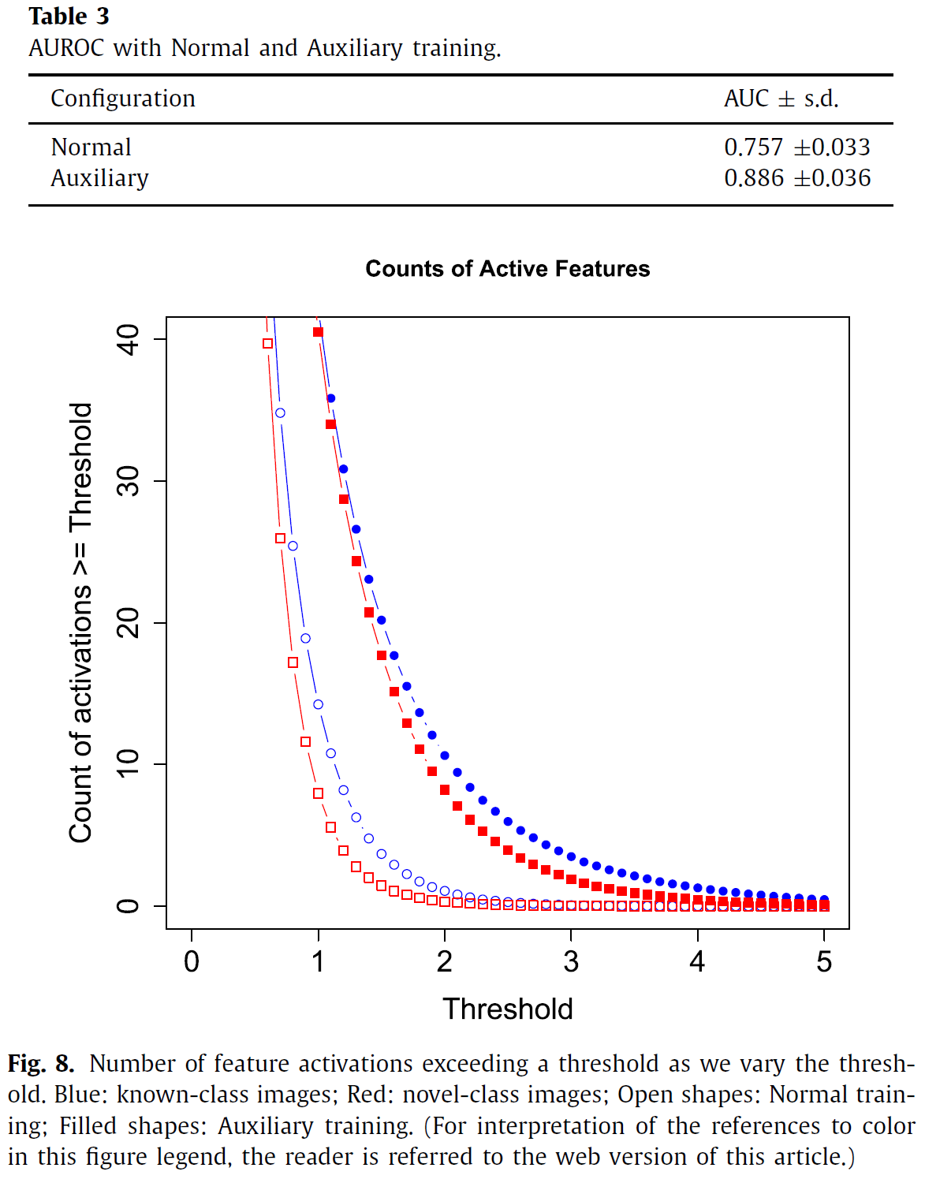
Prediction 3: auxiliary classes will improve classification and unknown detection because of their features.

Slide 33
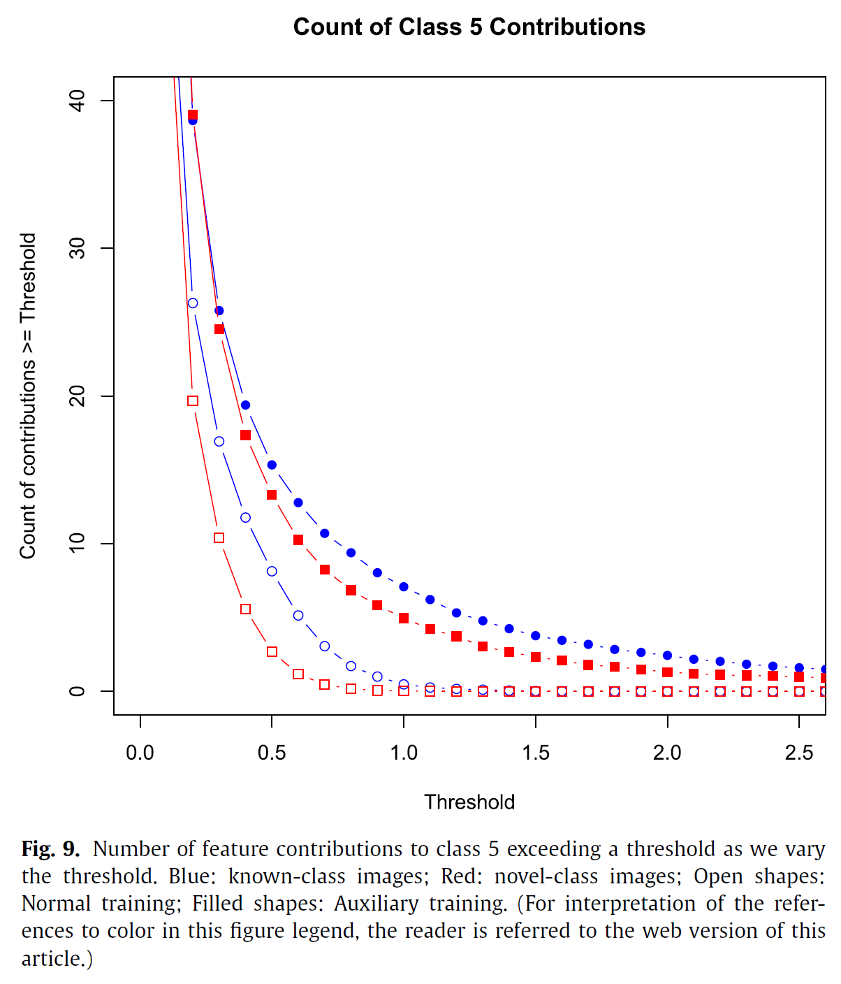
Activation → contribution, similar trends.

Slide 34
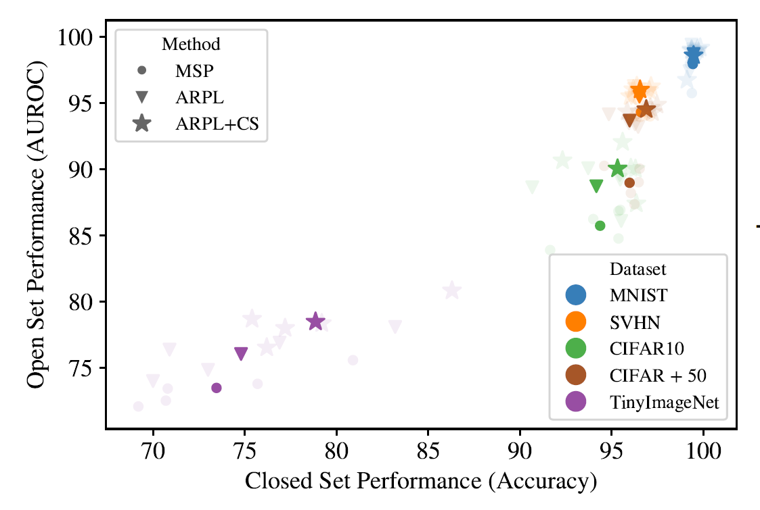
Why a good close-set classifier is a good open set recognition?
Good feature space is the secret.
A good close set requires to learn more positive presence feature.
Open-set recognition: A good closed-set classifier is all you need. ICLR 2022, citation: 94 (2023/3/23)

Slide 35
Conclusion
The Familiarity Hypothesis (FH) : The standard model succeeds primarily by detecting the absence of familiar features in an image rather than by detecting the presence of novel features in the image.
Positive presence | Negative presence
Positive absence | Negative absence
Four type of features.
Inspiration: the feature space is elusively embraced by most of current OSR methods.
Challenges:
False positive unknown detection : occlusion and blurring.
False negative of known:
One image with two objects, known and unknown.
Unknown objects with the feature of known and novel features.

Slide 36
Thank You
Questions and comments.

